Slide 1
CSS 422 Hardware and Computer Organization
CPU Architecture and Assembler
Ver. 3
Professor: Munehiro Fukuda

Slide 2
Topics
CPU Architecture
Embedded systems, microcontrollers, and microprocessors Programming
RISC vs CISC and Harvard vs von Neuman
Memory architecture
Memory map
Memory endianness
Memory alignment
First assembly program
ARM Instruction Sets
VisUAL

Slide 3
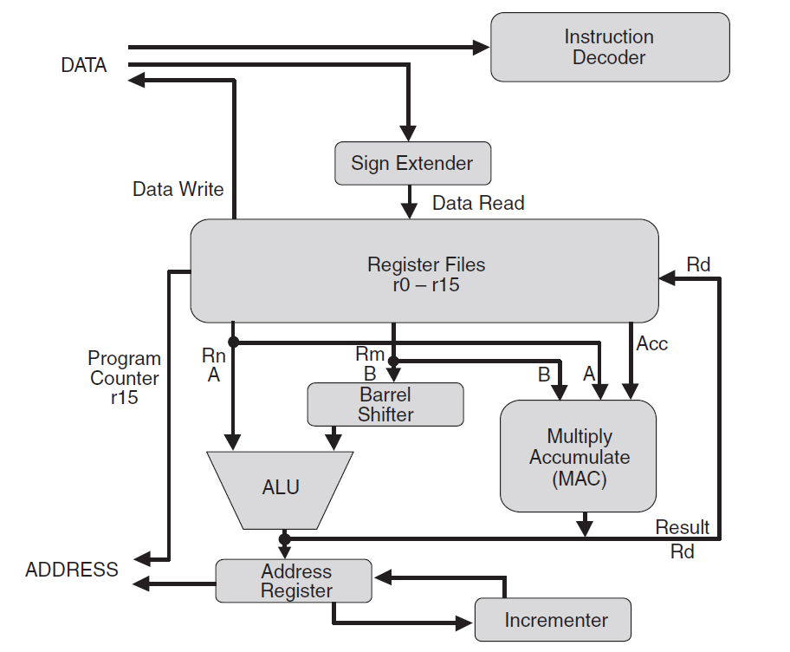
Embedded Systems, Microcontrollers, and Microprocessors
Embedded System
Microcontroller
(General computer system)
Microprocessor
Berger: Hardware and software organization: the software perspective
Tahir: ARM uProcessor Systems
register files
code/data memory
Busses
ALU
What CSS422 studies include
I/Os

Slide 4
Microprocessor
To be more specific,
there are Din/Dout registers here.
D0..D31
Memory
A0..A31
Peripherals

Slide 5
How Microprocessor Works
C:
int *data = 0x20000000;
*data = 5 + 7;
Assembler
MOV r0, #5
MOV r1, #7
ADD r2, r0, r1
LDR r3, =0x20000000;
STR r2, [r3]
Machine Code
F04F 0005
F0F4 0107
EB00 0201
F04F 5300
601A
To get the corresponding machine code, you can use
https://armconverter.com/
or
Keil uVersion (installed on UW1-310 windwos)

Slide 6
Instruction Pipelining
Clock
Step 1
Step 2
Step 3
Fetch
Decode
Execute
Instruction 1
Clocks per instruction = 3
Fetch
Decode
Execute
Instruction 2
Fetch
Decode
Execute
Instruction 3
Clocks per instruction = 1
Instruction
reading
Data
writing
Collison on memory

Slide 7
CPU Architecture: RICS vs CISC Memory Architecture: Harvard vs von Neuman
Simplified hardware
Relying on compilers
Complex hardware
Easy compilation
RISC
CISC
0x00000000
0x1FFFFFFF
Code
Memory
Code
Memory
ICode Bus
System Bus
System Bus
Data
Memory
Data
Memory
0x20000000
0x3FFFFFFF
ARM

Slide 8
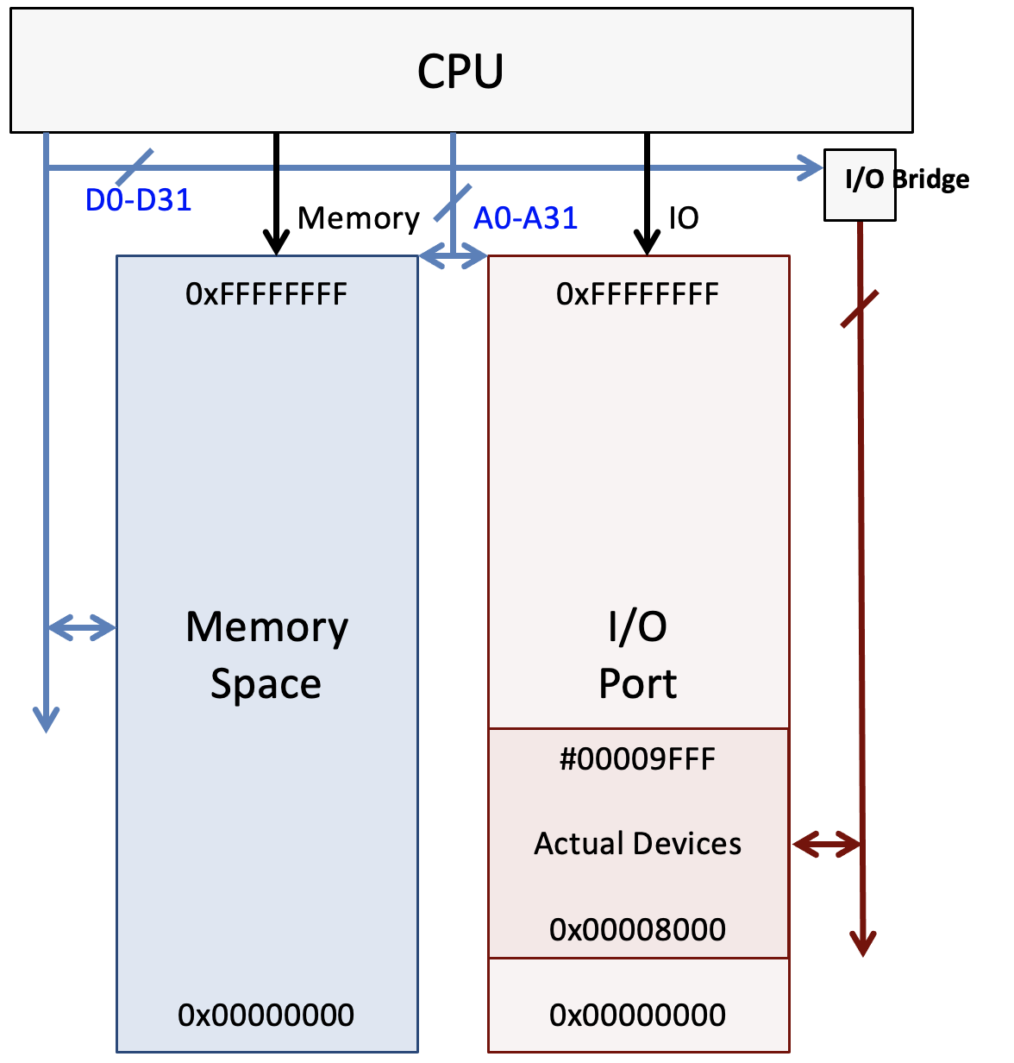
Memory Map
Memory-mapped I/O
ARM Cortex-M3
Port-mapped I/O
Intel

Slide 9
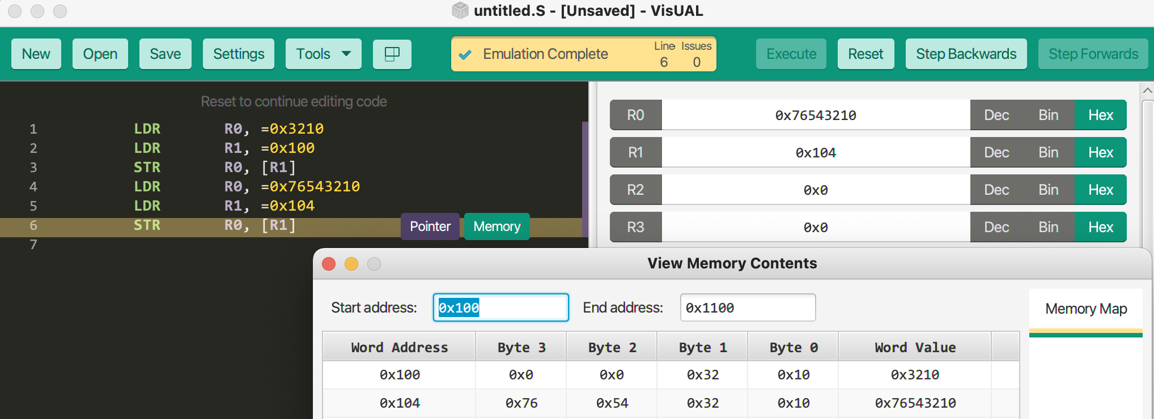
Memory Endianness
Big-endian order
Little-endian order
IBM 360 – z/Architecture
PDP-10
MC68000
24-bit addresses
16MB: 0x000000-0xFFFFFF
3 data widths
Byte: 8 bits
Word: 16 bits
Longword: 32 bits
Intel x86
AMD65/x86-64
ARM
32-bit int
memory
0x 01ABCDEF
memory
0xFF00
0xFF01
0xFF02
0xFF03
01
0xFF00
0xFF01
0xFF02
0xFF03
EF
AB
CD
CD
AB
EF
01
Memory
0x000000 Byte0 Byte1
0x000002 Byte2 Byte3
0x000004 Byte4 Byte5
0x000000 Word0 MSB Word0 LSB
0x000002 Word1 MSB Word1 LSB
MOVE #$3210, 4 0x000004 0x32 0x10
0x000000 Longword0 MSW
0x000002 Longword0 LSW
0x000004 Longword1 MSW
0x000006 Longword1 LSW
MOVE #$76543210, $8 0x000008 0x76 0x54
0x00000A 0x32 0x10

Slide 10
Memory Alignment
D0
D0
word0
byte1
byte1
D7
Longword0-1
Half word or Word memory operations, should be applied to only even addresses.
For a misaligned transfer, more than one bus cycle may be required:
Degrades CPU performance
Instruction words should be aligned on word boundaries: otherwise bus error.
word0
Longword0-2
D8
16-bit wide data bus
D7
16-bit wide data bus
D8
byte0
byte0
D15
D15
D0
D0
Longword1
byte3
byte3
D7
word1
D7
D8
D8
Longword0
byte2
byte2
D15
Longword0
D15
word0
32-bit wide data bus
D16
32-bit wide data bus
D16
byte1
byte1
D23
word0
D23
D24
D24
byte0
byte0
D31
D31

Slide 11
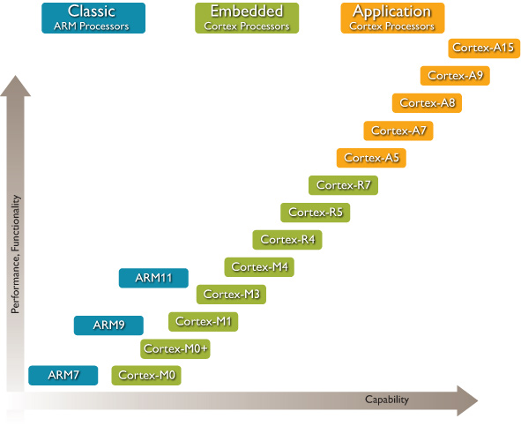
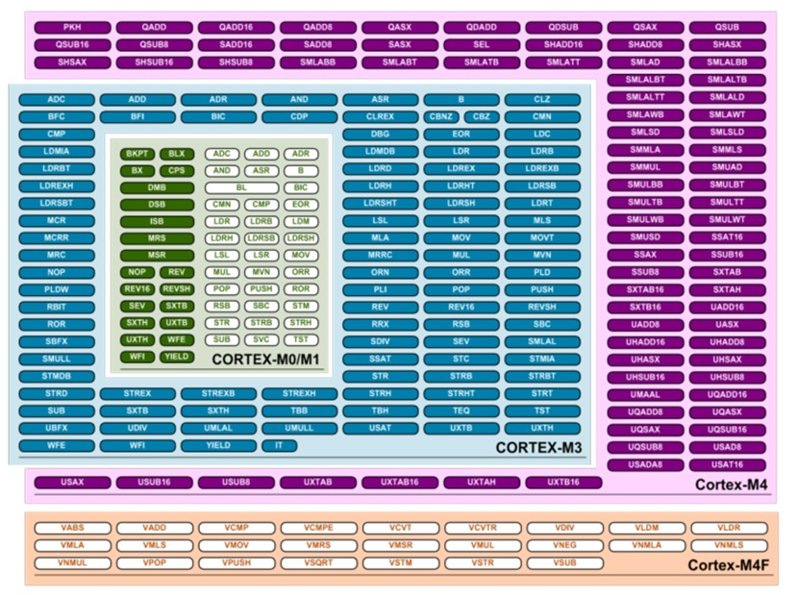
ARM CPUs
ARM
For general RISC computer systems
ARM CorTex (Core Texas)
Cortex-M: for microcontrollers
Cortex-A: for high-performance applications
Cortex-R: for real-time applications
http://stringinthemaze.blogspot.com/2012/05/

Slide 12
ARM CPU Registers
Program status registers (PSR)
Application
Interrupt
Execution
Negative
Zero
Carry
Overflow
Saturation IRQ being handled
ICI/IT: Interrupt–continuable instruction / if—then instruction block
Thumb: 1 in Cortex-M
DSP result’s reached MAX/MIN values.
Multi-cycle instructions to be restarted after an interrupt

Slide 13
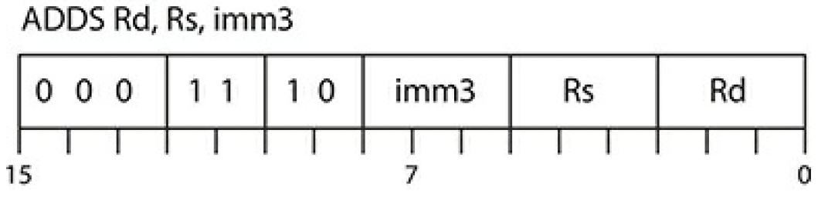
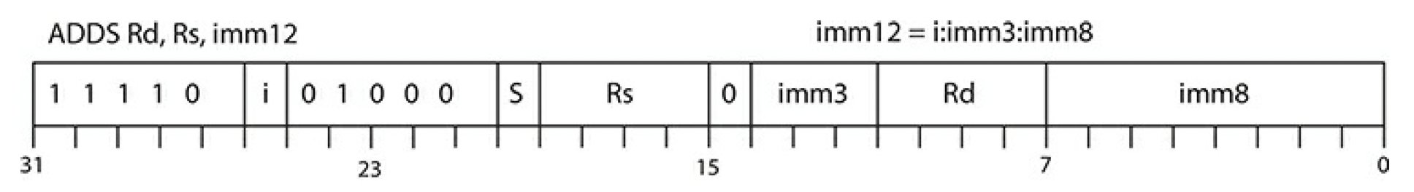
ARM Instruction Sets
ARM processors
ARM state: 32-bit word aligned instructions providing higher performance.
Thumb state: 16-bit half-word aligned instructions providing higher instruction code density.
Cortex-M processors
Thumb2 instruction set
No state switching
16-bit instructions and 32-bit instructions to be used together
ADDS R1, R0, #0x5:
ADDS R1, R0, #0x123:

Slide 14
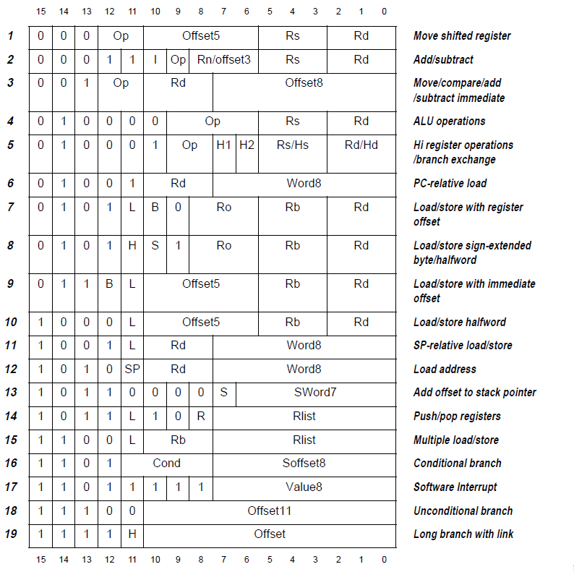
Thumb 16/32-bit Instruction Encoding
Thumb-2 instructions are identified by their most significant 5 bits being 11101, 11110, or 11111.
https://www.sciencedirect.com/topics/computer-science/conditional-execution
For each instruction decoding, refer to
https://developer.arm.com/documentation/ddi0403/ee/?lang=en

Slide 15
Assembly Programming Basics
Label | Opcode | Operand_1, 2, ... n | ; Comments
begin | MOV | R0, #5 | Move constant 5 to R0
 | MOV | R1, #7 | Move constant 7 to R1
 | ADD | R2, R0, R1 | Store R0 + R1 into R2
 | B | begin | Jump to begin
Four fields per line
Label: an optional field to determine the address of the corresponding CPU instruction
Opcode: a mandatory CPU instruction
Operand: mainly 1-3 operands manipulated by the given opcode
Comment: an optional comment field
Instruction Set
Data processing: MOV, ADD, SUB
Memory access: LDR, STR, LDM, STM
Branch & control: B, BX, BL, BLX

Slide 16
First Assembly Program
MOV R0, #0 ; R0 will accumulate the sum
MOV R1, #2 ; R1 will have the update even number
MOV R2, #5 ; the counter for the loop
lbegin
CMP R2, #0 ; If R2 != 0 continue with the next instructions
BEQ lend
ADD R0, R0, R1
ADD R1, R1, #2
SUB R2, R2, #1 ; branch unconditionally to lbegin
B lbegin
lend
Note: this program runs only on VisUAL but need additional code to run on a real Cortex-M processor

Slide 17
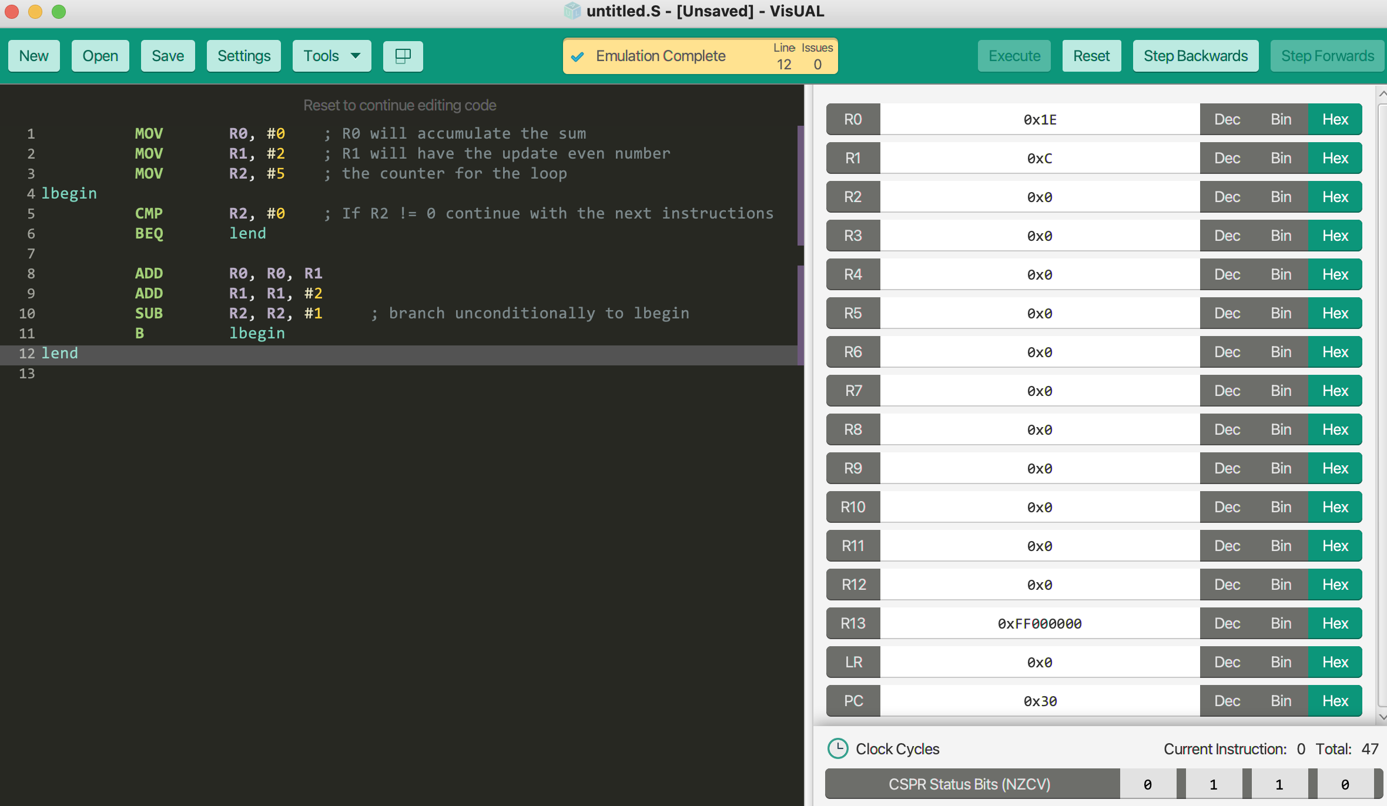
VisUAL
Overview:
VisUAL supports a subset of ARM instructions: https://salmanarif.bitbucket.io/visual/supported_instructions.html
Four assembly directives are covered: DCD, EQU, FILL, and END
Memory views:
Data views are supported.
Code views (i.e., machine code) cannot be viewed.
The code needs additional assembly directives and memory arrangement for running on a real Cortex-M
Instructions:
Visit: https://salmanarif.bitbucket.io/visual/
Download the simulator from: https://salmanarif.bitbucket.io/visual/downloads.html
Run: the first assembly program

Slide 18
Summary
What is the difference between RISC and CISC?
What deteriorates the performance of instruction pipelining?
What is the difference between memory-mapped and port-mapped I/O?
What is the difference between big and little endian orders?
What happens if a CPU instruction or a data item is not aligned memory?
Why does CPUs in general need status registers?
How can you identify given (half) words in code as a 16 or a 32-bit instruction?
What is the difference between CPU instructions and assembly directives?

